Slide 1

Introduction to .NET
Content :
  Introduction to .NET Technology
  Introduction to Web Based Applications
  Introduction to ASP.NET

Slide 2
Introduction to .NET Technology
Notes:
© Accenture 2006
Course Code Z16828
ATS Application Programming: C# .Net Programming
2.1 Introduction to .NET Technology

Slide 3
What is .Net?
The .Net framework is a software development platform developed by Microsoft. The framework was meant to create applications, which would run on the Windows Platform. The first version of the .Net framework was released in the year 2002.
The version was called .Net framework 1.0. The .Net framework has come a long way since then, and the current version is 4.7.1.
The .Net framework can be used to create both - Form-based and Web-based applications. Web services can also be developed using the .Net framework.
Notes:
© Accenture 2006
Course Code Z16828

Slide 4
.NET Framework Objectives
The .NET Framework is designed to fulfill the following objectives:
  Provide object-oriented programming environment
  Provide environment for developing various types of applications, such as Windows-based applications and Web-based applications
  To ensure that code based on the .NET Framework can integrate with any other code
Notes:
© Accenture 2006
Course Code Z16828
ATS Application Programming: C# .Net Programming
2.1 Introduction to .NET Technology
Faculty Notes:

Slide 5
.NET Framework
VB
C++
C#
JScript
…
Visual Studio 20171
Common Language Specification
ASP.NET
Windows Forms
ADO.NET
Base Class Library
(CLR) Common Language Runtime
Operating System
Notes:
© Accenture 2006
Course Code Z16828
ATS Application Programming: C# .Net Programming
2.1 Introduction to .NET Technology
Faculty Notes:
Figure above illustrates the Microsoft .NET Framework. All .NET languages are built on a Common Language Specification. While designed specifically to support the .NET versions of Visual Basic, C++, C# and JScript, .NET also supports other languages that can be modified to this specification. These include Perl, Python, COBOL, Eiffel, Pascal, Fortran, SmallTalk, Java, RPG, Ada, APL, J# and others.
The .NET Framework is designed to unify programming models to enable cross-language integration.
The Microsoft Active Server Page (ASP) technology has been enhanced as ASP.NET and is designed to allow the easy development of Web services and Web forms see figure above. The development of Windows forms has also been improved with .NET, and ADO.NET provides full support for data and XML. Visual Studio 2005 supports and integrates all of these development environments, automating many development tasks that previously required manual integration.
Each of the languages in the figure is supported by Visual Studio 2005, which is an enhanced IDE. The other languages discussed earlier can also be added to Visual Studio 2005. The strategy behind Visual Studio 2005 is to enable applications to be developed within Windows for later execution in a .NET environment on any platform.

Slide 6
The .NET Framework consists of:
  Common Language Specification (CLS)
It defines a set of rules and restrictions that every language must follow which runs under .NET framework. The languages which follow these set of rules are said to be CLS Compliant. In simple words, CLS enables cross-language integration or Interoperability.
Common Type System (CTS)
It describes the datatypes that can be used by managed code. CTS defines how these types are declared, used and managed in the runtime. It facilitates cross-language integration, type safety, and high-performance code execution.
Notes:
© Accenture 2006
Course Code Z16828
ATS Application Programming: C# .Net Programming
2.1 Introduction to .NET Technology
Faculty Notes:
Just read out the slide the sub point are explained in next slide

Slide 7
Base Class Libraries (BCL)
The .NET Framework includes a set of standard class libraries. A class library is a collection of methods and functions that can be used for the core purpose.
Common Language Runtime (CLR)
The "Common Language Runtime" or CLI is a platform on which the .Net programs are executed.
The CLR has the following key feature
Exception Handling
Garbage Collection

Slide 8
Common Language Runtime (CLR)
CLR Ensures:
  A common runtime environment for all .NET languages
  Uses Common Type System (strict-type & code-verification)
  Memory allocation and garbage collection
  Intermediate Language (IL) to native code compiler. Which Compiles MSIL code into native executable code
  Security and interoperability of the code with other languages
Notes:
© Accenture 2006
Course Code Z16828
ATS Application Programming: C# .Net Programming
2.1 Introduction to .NET Technology

Slide 9
Execution in CLR
Source code
VB
C#
C++
Compiler
Compiler
Compiler
Managed
code
Assembly
IL Code
Assembly
IL Code
Assembly
IL Code
Common Language Runtime
JIT Compiler
Native Code
Operating System Services
Notes:
© Accenture 2006
Course Code Z16828
ATS Application Programming: C# .Net Programming
2.1 Introduction to .NET Technology
Faculty Notes:
We already know that an assembly does NOT contain native binary code, but instead MSIL code. Obviously before the MSIL code can be executed it must be converted into native binary instructions. Converted? Does this mean interpreted? NO! The MSIL code is compiled and not thrown away. This means that the next time the code is requested it is already in the form of machine instructions and thus this mechanism in the log run is far more efficient than an interpreter for example.
The compilation is carried out by a JIT (Just In Time) compiler. Does the compiler compile all of the code in one go? The answer to this question is NO. If this approach was taken there would be a long delay during the applications initialization, and realistically not all the code within the module will be required in one go. Instead, when the code is loaded a ‘stub’ is connected to each method. When a method is called via the stub the compiler generates the binary native code. This mechanism goes a long way to describing why the compiler is called a ‘JIT’ compiler.
Compiled code is only saved in the same process (run) of an application. And even then it's not guaranteed. We do what's called "code-pitching" which means we through away cold (or little used) JITed code if memory pressure requires it. We do persisted JITed code in the install time scenario.
The benefit to this system is obviously portability. A couple of things to think about -
Let’s imagine you’ve built a managed component for the Intel Pentium III platform. It works fine. Later in the year Intel released a super new chip. When Microsoft released a new version of the JIT, it’s possible that this brand spanking new version of the JIT will have learned a few new tricks e.g. to make use of the new improved instruction set of the new Intel chip or new CPU registers!
And finally, Microsoft plans to offer a tool called PREJIT. This tool will compile your assemblies into native code and save the resultant binary executable code to disk. When the assemblies are next loaded the binary code is already available thus improving startup time and execution speeds.

Slide 10
Visual Studio 2017 IDE
  Microsoft has introduced Visual Studio.NET, which is a tool (also called Integrated Development Environment) for developing .NET applications by using programming languages such as VB, C#, VC++ and VJ#. etc.
Notes:
© Accenture 2006
Course Code Z16828
ATS Application Programming: C# .Net Programming
2.1 Introduction to .NET Technology

Slide 11
C# (C Sharp)
Microsoft C# (pronounced C Sharp) developed by Microsoft Corporation, USA
New programming language that runs on the .NET Framework
C# is simple, modern, type safe, and object oriented
C# code is compiled as managed code
Combines the best features of Visual Basic, C++ and Java
Notes:
© Accenture 2006
Course Code Z16828
ATS Application Programming: C# .Net Programming
2.1 Introduction to .NET Technology
Faculty Notes:
C# code is compiled as managed code, which means it benefits from the services of the common language runtime. These services include language interoperability, garbage collection, enhanced security, and improved versioning support.

Slide 12
C# Features
Simple
Modern
Object-Oriented
Type-safe
Versionable
Compatible
Secure
Notes:
© Accenture 2006
Course Code Z16828
ATS Application Programming: C# .Net Programming
2.1 Introduction to .NET Technology
Faculty Notes:
Simple – It simplifies the use of operators such as -> :: and pointers. It treats integers and boolean data types as two different types.
Modern – because it supports:
Automatic garbage collection
Rich model for Error handling
Decimal Data type for Financial applications
Robust Security model
Object –Oriented:
Supports all the tenets of an object-oriented system
Encapsulation
Inheritance
Polymorphism
Type-Safe:
Dynamically allocated objects and arrays are initialized to zero
Access to arrays are range bound and warned if it goes out of bounds
C# enforces overflow checking in arithmetic operations
Reference parameters that are passed are type-safe
Versionable:
New versions of software's work with existing applications this is known as versioning
Compatible:
Enforces .NET common language specifications and there fore allows inter-operation with other .NET languages

Slide 13
Introduction to Web Based Applications
Notes:
© Accenture 2006
Course Code Z16828
ATS Application Programming: C# .Net Programming
2.1 Introduction to .NET Technology

Slide 14
Introduction to ASP.NET
ASP.NET is part of the Microsoft .NET framework.
ASP.NET is an effective and flexible technology for creating interactive and dynamic web pages.
Notes:
.NET: Software Engineering II
4.1 Introduction to ASP.NET
© Accenture 2006 All Rights Reserved
Faculty Notes
ASP.NET applications can be written in any .NET compatible language like Visual Basic .NET, C#, and JScript .NET.

Slide 15
Introduction to ASP.NET
It is built on .NET Common Language Runtime
Provides better user authentication
Has better language support.
Has a large set of new controls (web controls)
Uses compiled code, which increases the
performance of the applications
It is programmable using any of the .NET languages
(VB.NET, C#, VJ# etc).
The ASP.NET pages are saved with the .aspx extension.

Slide 16
Advantages of ASP.NET
Easy Programming Model
Flexible Language Options
Compiled Execution
Rich Output Caching
Web-Farm Session State
Enhanced Reliability
Master Pages
Themes
Improved Security
Web Services
Improved Performance and Scalability
Notes:
.NET: Software Engineering II
4.1 Introduction to ASP.NET
© Accenture 2006 All Rights Reserved
Faculty Notes
Review the points on the slide, and provide the following elaboration to each point:
Easy Programming Model: HTML-like style of declarative programming of Server controls lets you build great pages with very less code than with classic ASP. All Web browsers support ASP.NET page -- including Netscape, Opera, AOL, and Internet Explorer
Flexible Language Options: More than 25 .NET languages are supported by ASP.NET. This gives flexibility in choice of language
Rich Class Framework: Over 4500 classes and more that encapsulate rich functionality like XML, data access, file uploading, regular expressions, image generation, performance monitoring and logging, transactions, message queuing, SMTP mail are available in .NET Framework
Compiled Execution: ASP.NET application is up to date due to dynamic compilation, and this compiled execution makes the application fast
Rich Output Caching: Rendering of controls to XHTML is improved by output caching. Database caching enables the application to be notified when the underlying database changes, eliminating unnecessary queries
Web-Farm Session State: In a Web farm, ASP.NET session state lets you share session data and user-specific state values across all machines. A Web Farm comprises of multiple Web servers situated on different machines having the same Web Application running on them.
It is used for scaling up to increasing number of users and provide satisfactory response times.
Enhanced Reliability:
Master Pages - Using Master Pages, ASP.NET makes it easy to create and apply a common look-and-feel to your Web site. It ensures that the application is always available to users by automatically detecting and recovering from errors like deadlocks and memory leaks.
Themes: Using Themes, Web pages can be given a consistent appearance with the built-in support.
XHTML ComplianceUsing ASP.NET, XHTML-compliant pages can be easily created.
Improved Security ASP.NET helps you protect your data and users.
Built-in Protection ASP.NET has built-in protection from many common forms of hacker attacks, including cross-site scripting and more.
XML Web Services: ASP.NET makes exposing and calling XML Web Services simple. XML Web services allow applications to share data and communicate with other application over the Internet, irrespective of the type of operating system or programming language.
Improved Performance and Scalability: ASP.NET lets you use serve more users with the same hardware.

Slide 17
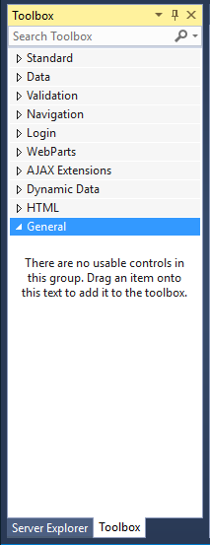
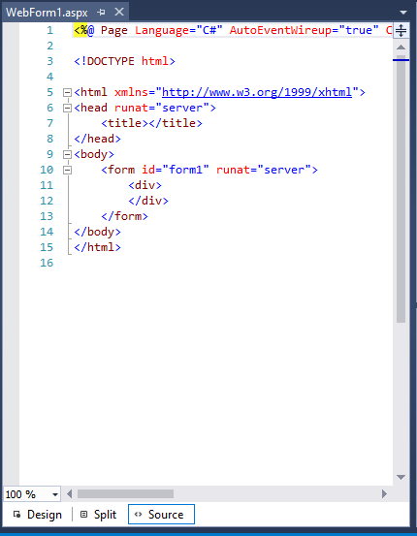
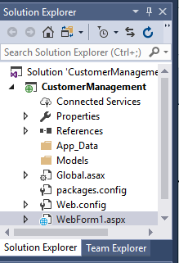
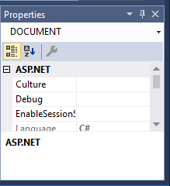
Visual Studio 2017 IDE
Title Bar
Menu Bar
Tool Box
Document window
Solution Explorer
Properties Window
Notes:
.NET: Software Engineering II
4.1 Introduction to ASP.NET
© Accenture 2006 All Rights Reserved
Faculty Notes:
Run this slide

Slide 18
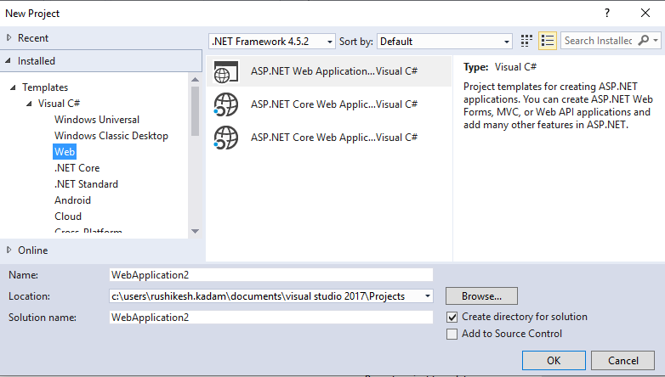
Creating a New Web Application
To start a new Web Application in VS 2008, Click the Create New Project button on the Start page or Select File > New > Project
The New Web Site allows
you to choose:
Templates
Language for creating an
Application
Location where the application
will be created
Notes:
.NET: Software Engineering II
4.1 Introduction to ASP.NET
© Accenture 2006 All Rights Reserved
Faculty Notes:
This slide demonstrates how to create a new Web Application in VS 2008.
You can also create other projects such as a Windows Application, Class Library, Console Application etc;
by selecting File > New > Project and then selecting the required project.

Slide 19
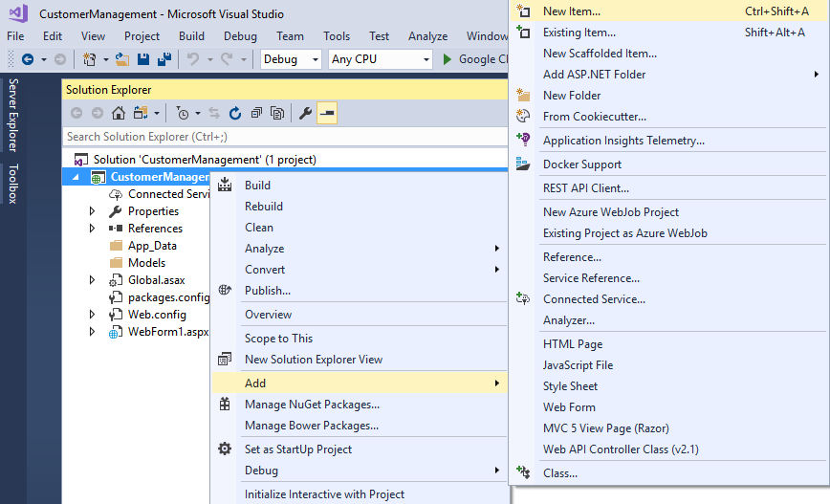
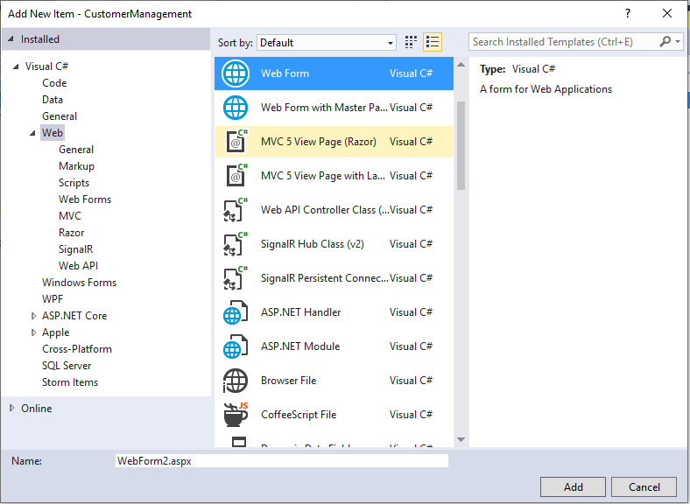
Files can be added to the Project, using Solution Explorer Right click on the project node, in the Solution Explorer, and select the option Add then click the New Item
  The Add New Item window will popup.
  Select the type of file (item) to be added and click on Add.
Notes:
.NET: Software Engineering II
4.1 Introduction to ASP.NET
© Accenture 2006 All Rights Reserved
Faculty Notes:
Read the content in the slide (Self-explanatory)

Slide 20
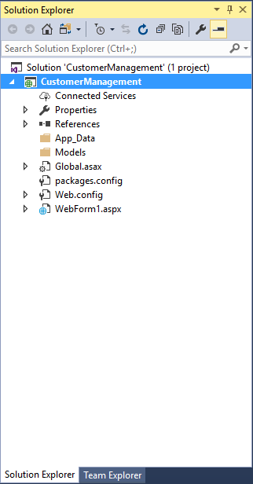
Solution Explorer
Presents a tree view structure of files present in the project.
  By default a New Project will contain:
    An App_Data folder
    A Global.asax file
    A Web.config file
To view Solution Explorer:
Select View > Solution Explorer
OR
Press buttons Ctrl+Alt+L
Notes:
.NET: Software Engineering II
4.1 Introduction to ASP.NET
© Accenture 2006 All Rights Reserved
Faculty Notes
Read the content in the slide (Self-explanatory)
Note: You can add multiple projects in a single Solution Explorer.

Slide 21

Solution Explorer (Continued)
The Toolbar at the top of Solution Explorer enables various tasks.
Code
Refresh
Copy Website
Properties
View Designer
Nest Related Files
ASP.NET Configuration
Notes:
.NET: Software Engineering II
4.1 Introduction to ASP.NET
© Accenture 2006 All Rights Reserved
Faculty Notes
Explain the following tasks:
Properties – Displays the properties window for the selected file
Refresh - Refreshes the Solution Explorer
Nest Related Files - Undoes the nesting found in
ASP.NET files developed by
using code-behind files
Code - Displays the code behind file/s
View Designer - Displays the document window
Copy Website – Enable you to copy your application from one point to another (on the same server or on a different server) by opening a new dialog in the document window
ASP.NET Configuration – Displays the ASP.NET configuration page within the document window

Slide 22
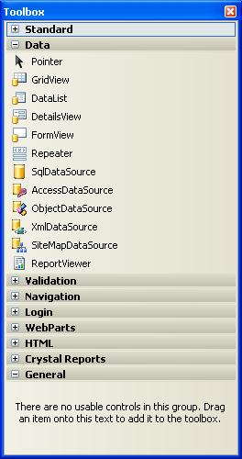
Toolbox
To add controls in the Design
Window use Toolbox.
There are various tool tabs
available in the Toolbox.
The controls in the IDE are presented in a
hierarchical manner (e.g., Standard Tab,
Data Tab, Validation,Navigation, WebParts etc.).
Depending on the type of project (application)
the toolbox tabs will vary.
Notes:
.NET: Software Engineering II
4.1 Introduction to ASP.NET
© Accenture 2006 All Rights Reserved
Faculty Notes
Read the content in the slide (Self-explanatory)
Use ToolBox to add controls in the Design Window.
Just drag and drop the required controls in the design window and the control gets added to your application.

Slide 23
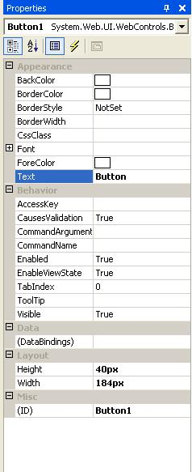
Properties Window
To view or change the properties and events of a selected control during design use the Properties Window
To configure a control:
  Click once to select it
  Press F4 or Select menu View > Properties window
  Modify the appropriate properties in the window
There are various options provided for viewing the properties of the selected control, such as:
  Categorized view
  Alphabetical view
  Properties view (default)
  Events View
  Property pages
Notes:
.NET: Software Engineering II
4.1 Introduction to ASP.NET
© Accenture 2006 All Rights Reserved
Faculty Notes:
Properties shown in grey are read-only
The default view for the Selected control properties view is displayed. Use:
Categorized View (to view the properties by category)
Alphabetical View (to view the properties in alphabetical order)
Events View (to view the events associated with the control)
Property Pages (to view the property page of an option)

Slide 24
Questions and Comments
???
Notes:
.NET: Software Engineering II
4.1 Introduction to ASP.NET
© Accenture 2006 All Rights Reserved
Faculty Notes:
Ask participants if they have any questions about the content covered in this presentation.

